Slide 1


EfficientVITON
An Efficient Virtual Try-On Model using Optimized Diffusion Process
Advisor : Prof. Ahmed Fares
Date : 05/02/2025

Slide 2
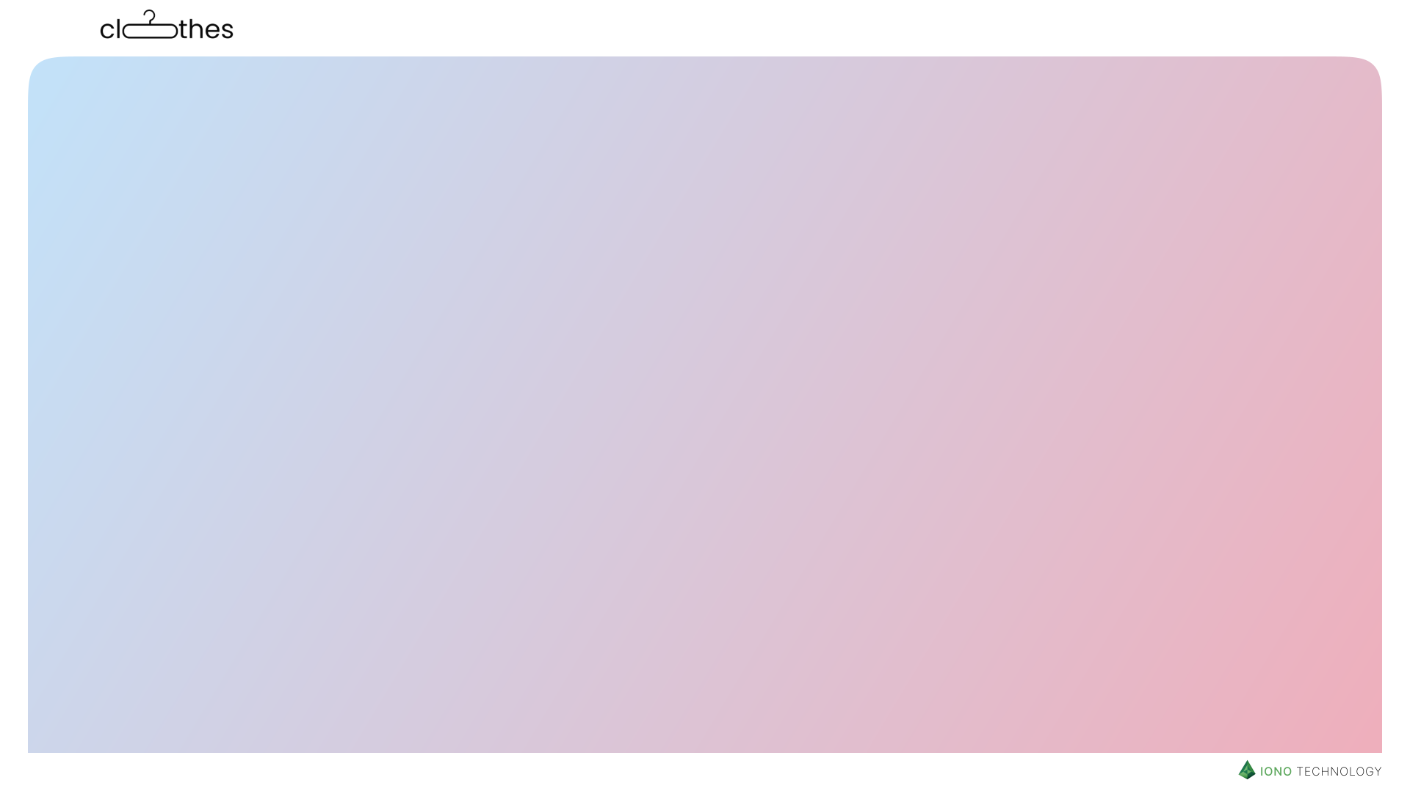



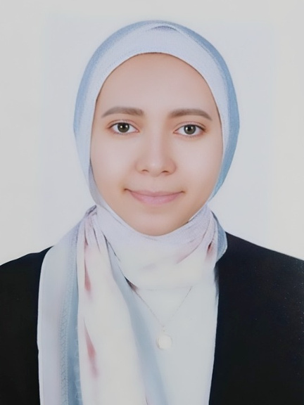


Meet the Team
Ashrakat Saeed
120200091
Abdelrahman Said
120200075
Ahmed Rashed
120200225
Mariam Ayman
120200094
Mostafa Atef
120200043
Sponsored by

Slide 3
Agenda
Introduction
Related Work
Methodology
Results & Discussion
Conclusion & Future Work

Slide 4

Agenda
Introduction
Related Work
Methodology
Results & Discussion
Conclusion & Future Work

Slide 5




Introduction
Motivation
Reduce e-commerce return rates (up to 30% due to try-on issues).
Promote sustainability by minimizing physical try-ons.
Problem Statment
Traditional virtual try-on methods heavily depend on paired datasets and external warping networks to align garments with the human body. However, these approaches face several critical challenges that limit their effectiveness and scalability.

Slide 6
Introduction
Virtual try-on systems face three key challenges
Challenge 1:
Challenge 2:
Challenge 3:
Detail Preservation
Computational Efficiency
Realistic Alignment
Maintaining garment details such as textures, patterns, and fabric folds remains a challenge, especially in high-resolution applications.
The iterative nature of many virtual try-on methods results in high computational demands, making real-time performance impractical.
Establishing precise correspondence between garments and body features.

Slide 7
Agenda
Introduction
Related Work
Methodology
Results & Discussion
Conclusion & Future Work

Slide 8
Related Work
Evolution of Virtual Try-On Methods
Geometric Warping (e.g., VITON)
✅ Low computational cost.
❌ Poor detail preservation.
GAN-Based Models (e.g., CP-VTON)
✅ Realistic outputs.
❌ Artifacts and unstable training.
Diffusion Models (e.g., TryOnDiffusion):
✅ High-fidelity details.
❌ Slow inference (e.g., 58s/image).
Research Gaps
Trade-off between speed and quality.
Limited generalization to diverse poses/body types.

Slide 9
Related Work
Model | Approach | Advantages | Limitations | Efficiency
CP-VTON | GAN-based, Warping | Generates realistic images, handles complex clothing patterns | Computationally expensive, can be unstable during training, may struggle with diverse poses | Moderate
VITON-HD | Warping-based | Relatively fast, good for simple clothing items | Limited ability to handle complex clothing textures/patterns, struggles with occlusions and challenging poses | High
TryOnDiffusion | Diffusion-based | High realism, handles complex scenes and poses | Requires large paired datasets, computationally expensive | Low
DCI-VTON | Diffusion-based, Warping | Uses pre-trained diffusion model, good realism | Relies on external warping network, inherits limitations of warping approaches | Moderate

Slide 10
Agenda
Introduction
Related Work
Methodology
Results & Discussion
Conclusion & Future Work

Slide 11
Methodology
01
02
03
04
05
EfficientVITON Model Architecture
Spatial Encoder and Zero Cross-Attention Blocks
Data Preprocessing
Optimized Diffusion Process
Loss Functions and Training

Slide 12
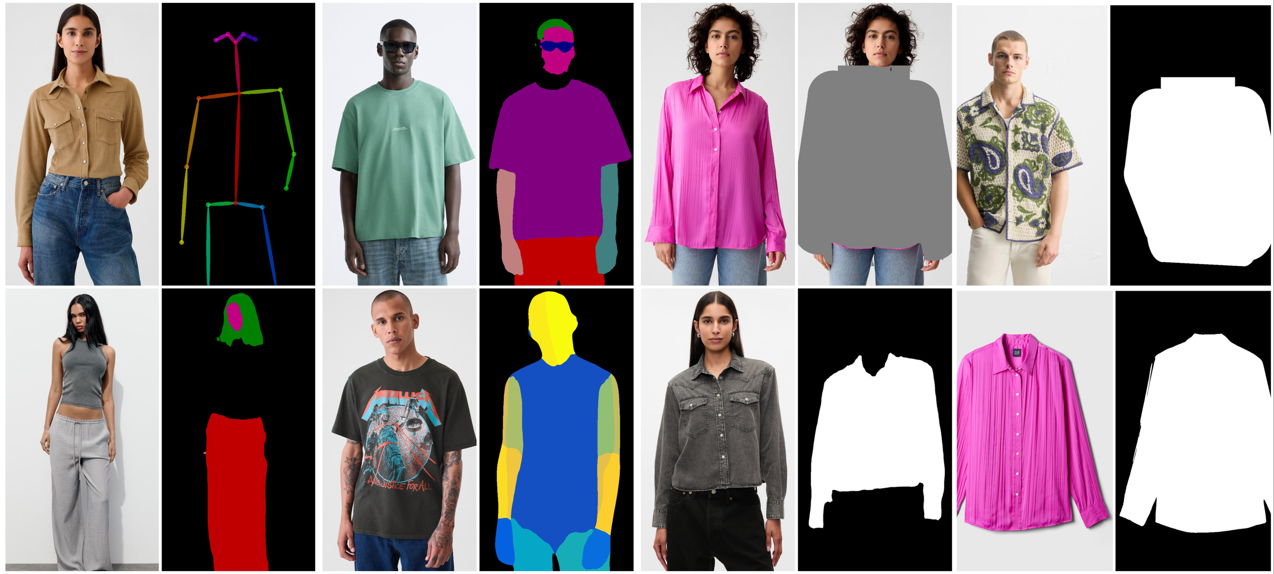
Data Preprocessing

Slide 13
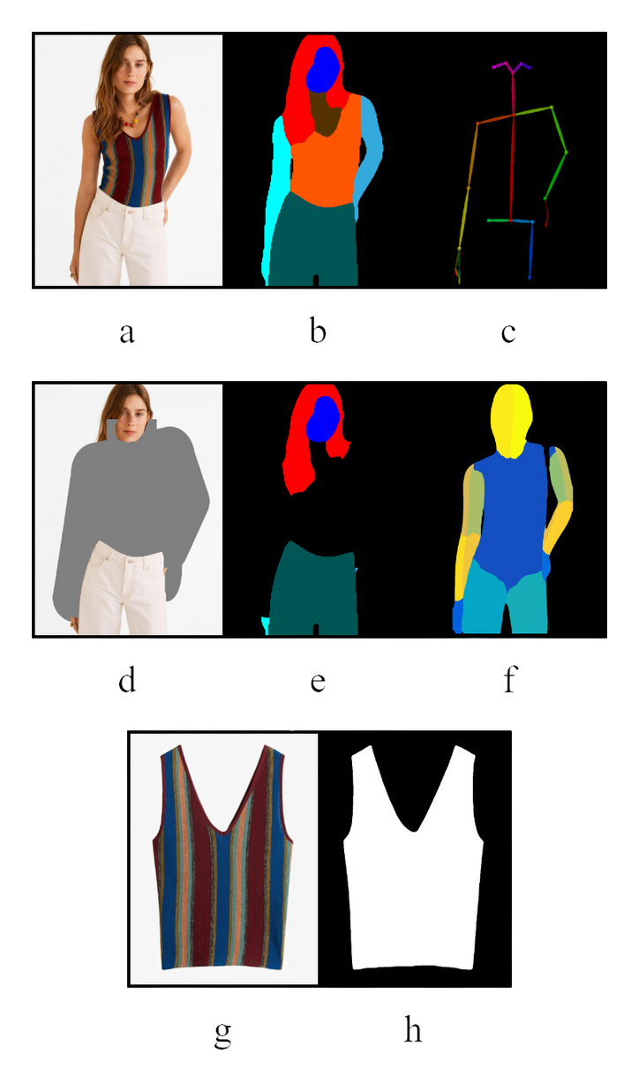

Data Preprocessing
01
The main training dataset used was VITON-HD. This dataset was a contribution for the research in one of the first virtual try-on researches by Choi et al.
02
The dataset contains over 11600 training images and over 2000 testing images.
03
All images are 1024x768 in terms of resolution. Each image in the dataset has its equivalent image of the unworn clothes.
04
In addition, the dataset handles most of the preprocessing steps, like the densepose, the human parsing, the pose estimation, etc.

Slide 14
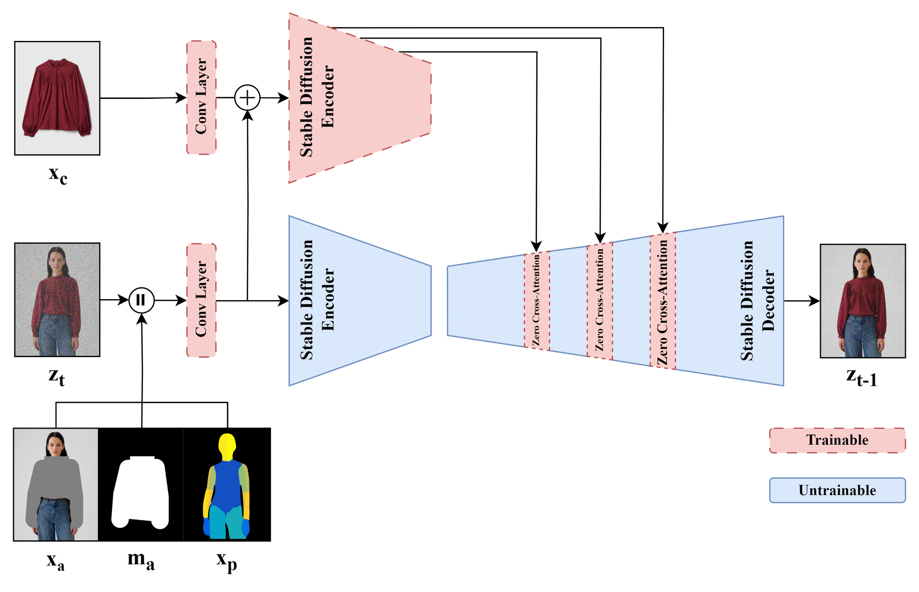
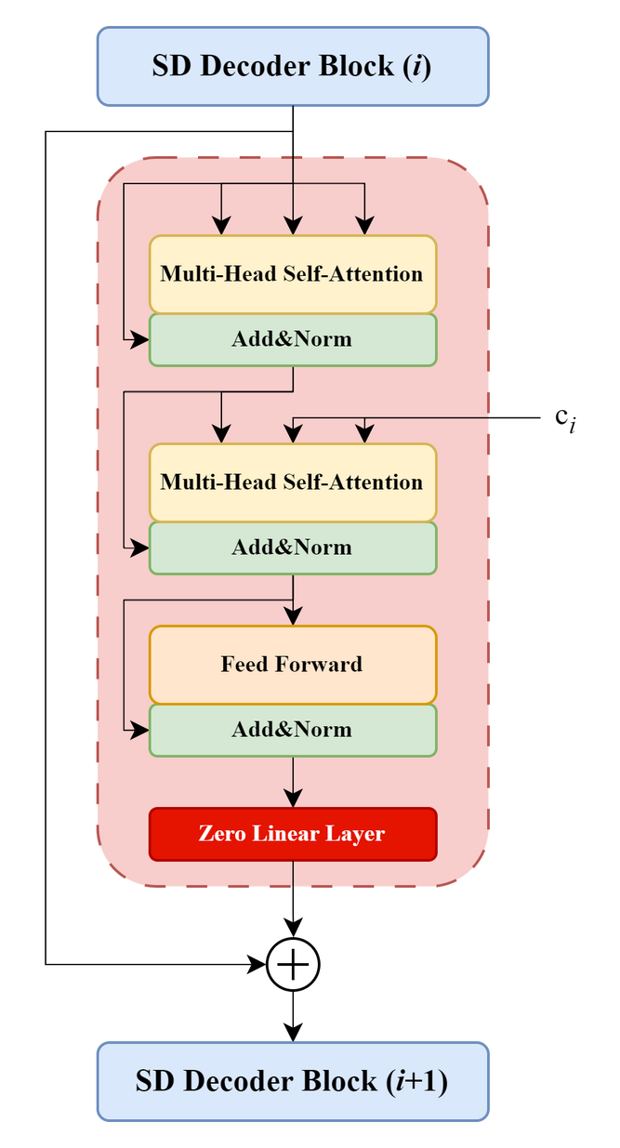
EfficientVITON Model Architecture

Slide 15
Optimized Diffusion Process
Base Model: Pre-trained Stable Diffusion v1.5 - Foundation for high-quality image generation.
Sampling Strategy: Improved DDPM Sampler - Reduced sampling steps for faster inference while maintaining quality. Instead of 50 uniformly distributed timesteps, we apply a non-uniform distribution of 10 timesteps in the denoising process.
 | LPIPS | FID
Uniform Timesteps (50) | 0.0732 | 8.233
Non-uniform Timesteps (10) | 0.0762 | 8.433
Latent Space Optimization: Direct manipulation in latent space - Efficient transformations and warping for clothing.

Slide 16
Spatial Encoder & Zero Cross-Attention Blocks
Zero Cross Attention Block
Spatial Encoder
The spatial encoder is initialized with the U-Net Encoder weights of the pretrained Stable Diffusion Model.
It produces feature maps at multiple resolutions as it downsamples the input clothing image.
Learns the relationship, or semantic correspondence, between the features of the clothing (extracted by the spatial encoder) and the regions of the person's body (represented by the U-Net's feature maps).
Patch-wise Warping: Transforms and warps clothing in latent space for precise fitting

Slide 17
Loss Functions & Training
Latent Diffusion Loss (LLDM) - Guides the denoising process in the latent space.
Where:
ζ: Concatenated latent inputs (noisy latent map zt , latent agnostic map E(xa ), agnostic mask xma , latent dense pose E(xp )).
xc : Clothing image.
ϵ: Random noise.
ϵθ : U-Net parameterized by θ.
t: Timestep.
Tϕ : CLIP image encoder parameterized by ϕ.

Slide 18
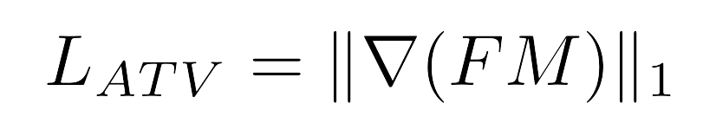
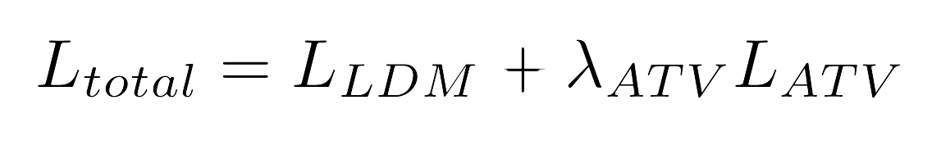
Loss Functions & Training
Attention Total Variation Loss (LATV) - Sharpens attention, enhances clothing detail.
Where:
F : Center coordinate map (derived from attention maps).
M : Ground truth clothing mask.
∇: Gradient operator.
Overall Loss:
Where:
λATV is a hyperparameter weighting the LATV

Slide 19
Loss Functions & Training
EfficientVITON's training process likely involves two stages:
Semantic Correspondence Learning
The model focuses on learning the semantic relationship between clothing and body parts.
The LLDM is the primary loss function during this stage.
2
Attention Refinement
The LATV loss is introduced to refine the attention maps.
This helps to sharpen the attention and improve the precision of clothing placement.
1

Slide 20
Augmentation Strategies: During training, various data augmentation techniques are used to make the model more robust, like Random Scaling, Random Rotation, Color Adjustments.
Agenda
Introduction
Related Work
Methodology
Discussion and Results
Conclusion & Future Work

Slide 21
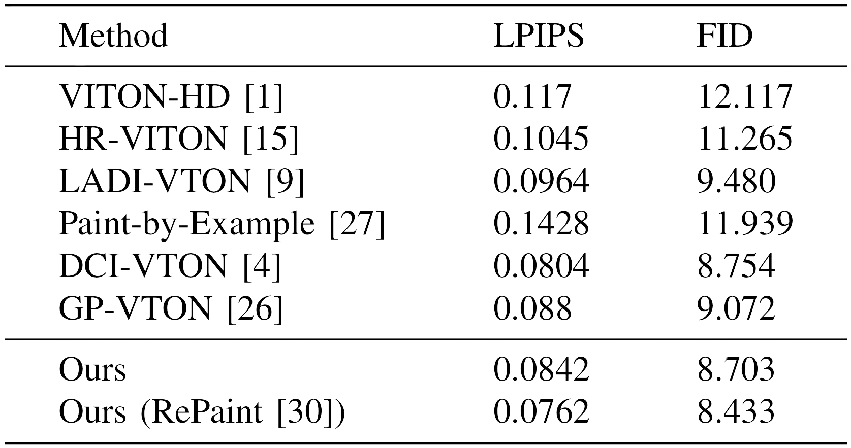
Results & Discussion
(Quantitative )
EfficientVITON achieves state-of-the-art FID scores and cuts inference time to 16 seconds, making real-time applications feasible.

Slide 22
Results & Discussion
(Quantitative )
 | LPIPS | FID
Uniform Timesteps (50) | 0.0732 | 8.233
Non-uniform Timesteps (10) | 0.0762 | 8.433
Method | Training | Inference
Before | 1570 h | 58 s
After | 859 h | 16 s

Slide 23
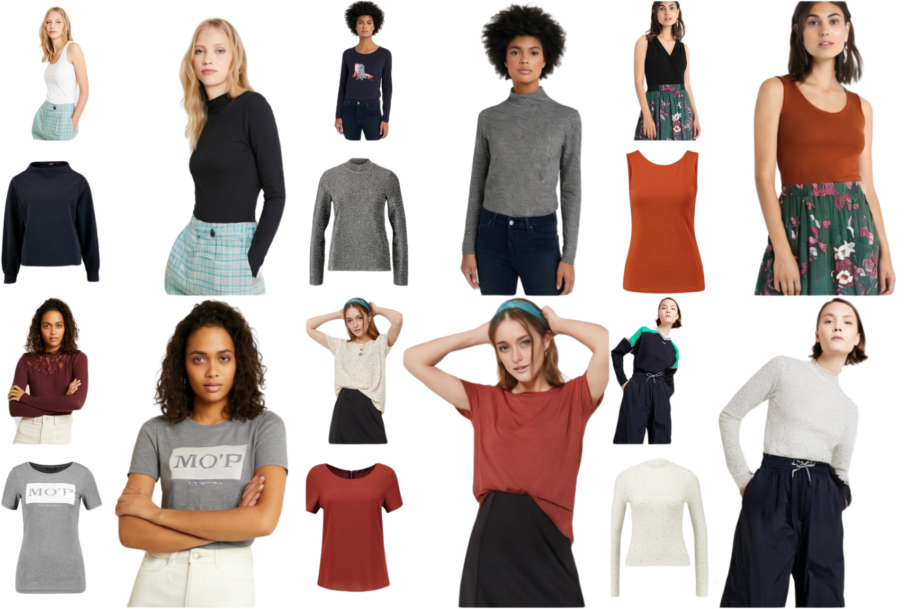
Results & Discussion (Qualitative)
Accurate alignment
(no warping).
Preserved textures (logos, patterns).

Slide 24
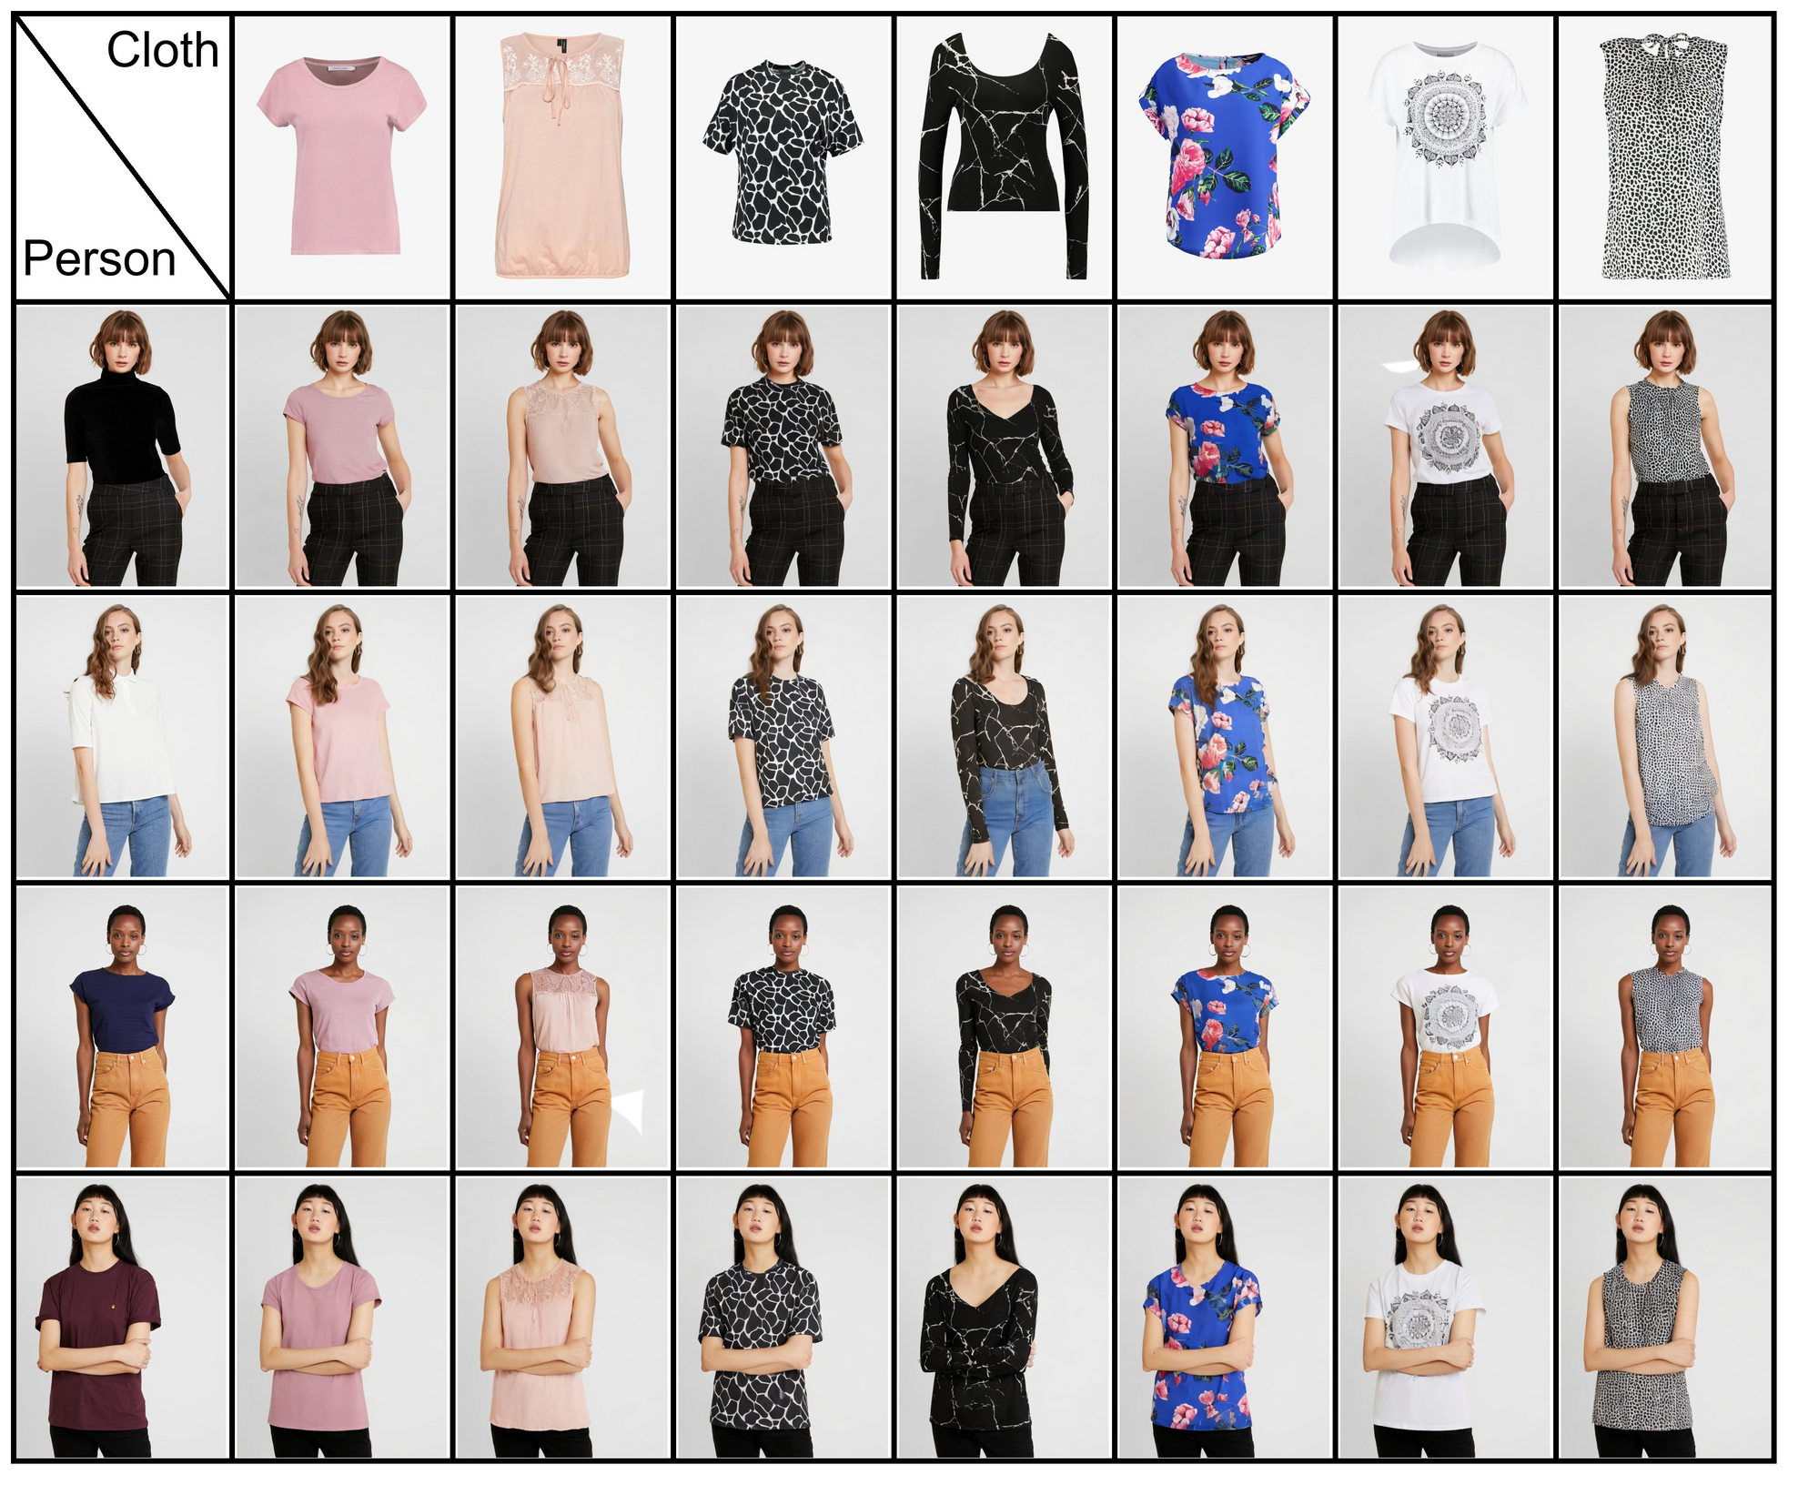

Slide 25
Agenda
Introduction
Related Work
Methodology
Results & Discussion
Conclusion & Future Work

Slide 26
Conclusion
Efficiency and Accuracy
Detailed Clothing Preservation
Improves Efficiency
EfficientVITON significantly improves the efficiency of virtual try-on while maintaining accuracy. Working within the compressed latent space further reduces computational overhead and allows for semantically meaningful clothing manipulations.
EfficientVITON excels at preserving intricate clothing details. The spatial encoder, initialized with U-Net weights, effectively captures fine-grained features such as textures, patterns, and logos.
The zero cross-attention blocks, learning the precise correspondence between clothing and body parts, enable highly accurate and realistic warping of clothing onto the person, resulting in a natural and convincing try-on effect.
72.4% decrease in inference time
This shows that our optimized method effectively boosts the model’s performance without sacrificing the caliber of the outputs it produces.

Slide 27
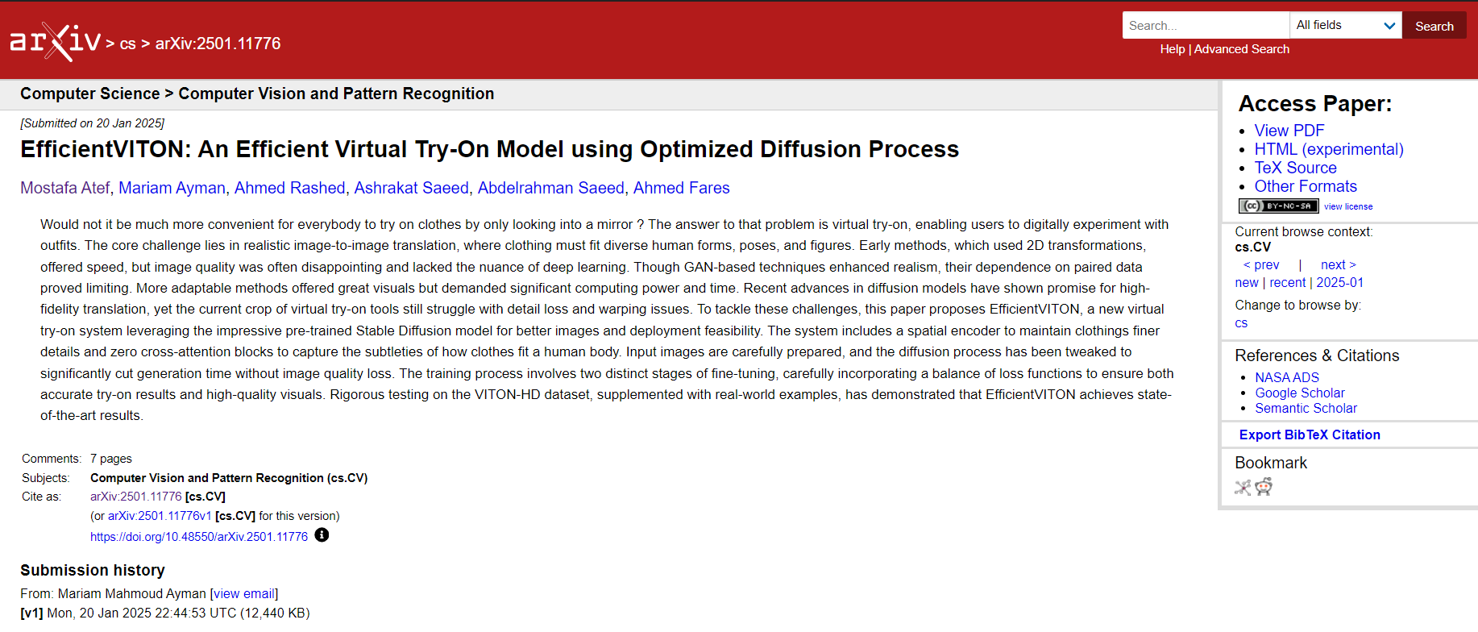
Conclusion
Impact and Publication
We believe EfficientVITON makes a significant contribution to the field of virtual try-on. Our work has been published on arXiv and we are currently preparing a manuscript for submission to a leading conference/journal in computer vision.

Slide 28
Future Work
Working on Dynamic Garment Simulation
Expanding on Diverse Datasets
To enhance realism further, we plan to incorporate physics-based simulations to model the dynamic behavior of clothing. This will allow EfficientVITON to capture the natural drape, folds, and wrinkles of garments, leading to even more convincing virtual try-on experiences.
Training on more diverse and representative datasets is crucial. We aim to expand our training data to include a wider range of body types, ethnicities, and clothing styles, thereby improving the generalizability and inclusivity of EfficientVITON.

Slide 29
Thank You
-ANY QUESTIONS?-

